Slide 1

MMA Datathon Fall’21
Team Data Pirates Presents Case Challenge
October 13, 2021 Prepared by Sonali Sachdev, Shulin Gu, Xinghui Li

Slide 2
Business Problem
Analyzing the Nebraska Mortgage Loan Market
To Maximize the dollar value while limiting the defaulting loan.
To Identify the right customer with highest possibility to make repayment.
Bank collaborated with Team Data Pirate to devise a recommendation to maximize the dollar value while keeping a check on interest rate and state of the economy.

Slide 3
Co-Creating Solution with Great Lakes Midwest Bank
Regional Bank in the state of Illinois, lowa and Wisconsin
As we Know..
It is imperative for banks to refinance mortgage and take preventive measure to reduce the defaulting loan.
To target right customer at right time requires solid predictive analytics model and intrinsic recommendations.

Slide 4
Data Source
Data via Fannie Mae( government-sponsored enterprise)
Dataset of all conventional single-family, fixed interest rate mortgages
From 2000 – 2021 Q1
Analyzed data of more than 270000 customers
43 Variables analyzed
270k rows of transaction to trace the data pattern.
Credit Scoring Model

Slide 5
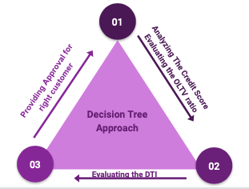
How We Helped the Bank Boost Customer Retentions
Key Challenges
The calculation of this data requires a large number of classification calculations based on the content of the data. Because of the uncertainty of the unpaid time and interest, it is necessary to calculate the actual received payment according to each actual situation.
Our strategy will calculate the actual received and expected receivables, and compare them, find the existing problems to carry out classification discussion.

Slide 6

Data Cleaning and Processing
Monthly Payment Equation:
M = P [ i(1 + i)^n ] / [ (1 + i)^n – 1]
P = principal loan amount
i = monthly interest rate
n = number of months required to repay the loan
Actual Amount Received (Up to LAST_DTE):
C, R, L = M * (LAST_DTE - FRST_DTE)
P = M * (LAST_DTE - FRST_DTE) + LAST_UPB
D = M * (F_DTE - FRST_DTE)
T, F, S, N = NET_LOSS + ORIG_AMT
Note: Ignore amortization interest when payment is not received
Expected Amount Receivable = M * ORIG_TRM

Slide 7

MODEL INSIGHTS
Bank Success through Co-Creation
After the data has been cleaned and new term has been added, a correlation table was made to show the correlation of each term with the amount received. Higher value indicate stronger effect (positive or negative) on the amount received.
From the table, the Original Loan Amount (orig_amt), Last Unpaid Balance (LAST_UPB), Monthly Payment has a higher correlation. Original term (orig_trm), Original Loan to Value Ratio (OLTV) and number of borrowers (num_bo) has a relatively lower correlation. And we will be focusing more on these terms.

Slide 8
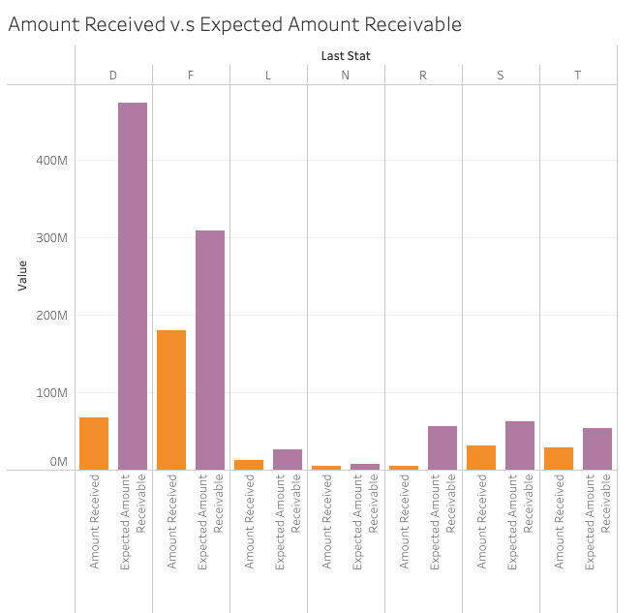
Amount Received v.s Expected Amount Receivable
We compared the the actual amount received and expected amount receivable. We found there are huge different amount D, F & R.
When we go to in-depth analysis, we should pay more attention to these trading categories, and should find problems, why? For example, you can pay attention to what they do for the second mortgage.

Slide 9
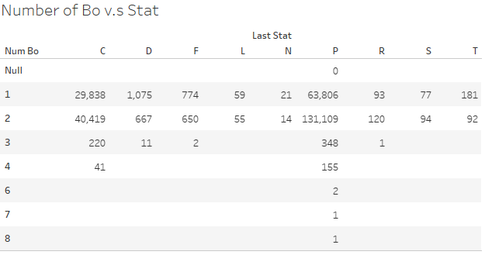
Number of Borrowers
With an increase in the number of borrowers, the amount of good loans (C & P) increase. And the amount of bad loan (D,T, L, F…) decrease.
We can conclude that 2 or more borrowers will secure the loan better.
Addition Tables about Credit Score can be found on github.

Slide 10
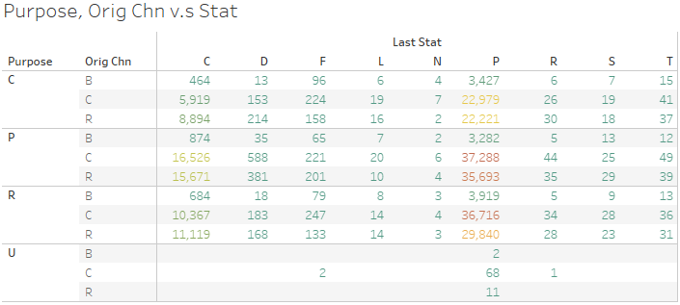
Purpose, Channel
In the following analysis, we found that for most loans that are not good, they are used to buy new real estate. This may involve the fact that when they use it for investment, they can’t get the rent back, which makes them unable to pay the loan.
And, for the loans processed by brokers, their loans are obviously better than those processed by other channels.

Slide 11
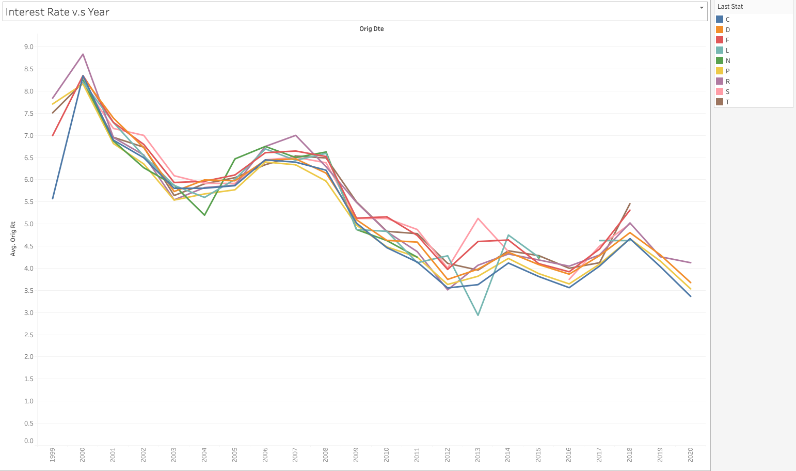
Interest Rate
It is a common sense that the higher the interest rate, the more money the bank will receive.
However, we cannot easily change the interest rate. And a relatively high interest might cause the borrower to pay off ahead of time, or even unable to afford the debt.
From the figure on the right, we can see the interest rate is descending throughout the year.
Thus increase the interest rate will be the last factor to be considered to maximize the profit.

Slide 12
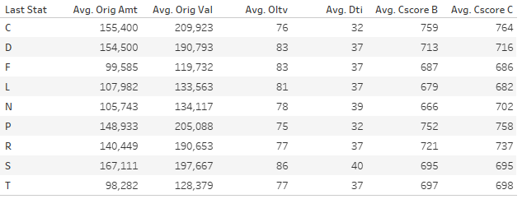
Loan and Borrower Data in Avg
From the table on the right shown, it turns out that C,P (good state of loan) have a lower Oltv and Dti value in average. And a higher average credit score.
We can conclude for a loan in good status (C,P):
- A lower original amount is lent to the borrower compare to the original value of the property.
- The borrower has a relatively lower monthly income compare to the monthly debt.
- The borrower has higher credit score.

Slide 13
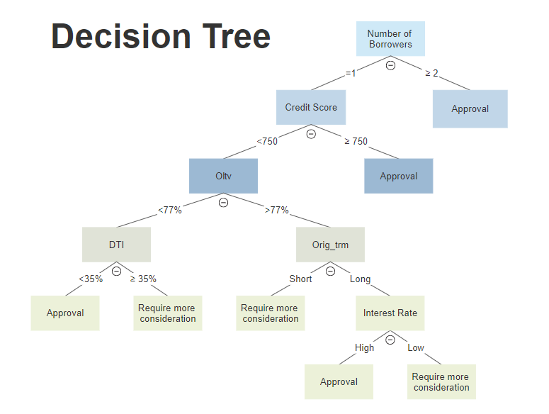

Slide 14
Recommendation for the Future
In order to maximize the dollar value of mortgage and limit the number of defaulting loans, we recommend to focus on the following segment:
Maximizing the dollar value of mortgage:
Lower Oltv ratio
Limit the number of defaulting loans:
Number of borrowers
Higher credit score of borrowers
Lower DTI ratio
Consideration for future interest rate:
Interest rate is descending throughout the year.
Higher interest rate for long term
Lower interest rate for short term
 | Recommended | Need More Consideration
Number of Borrowers | >1 | =1
Credit Score | ≥750 | <750
Oltv | ≥77% | <77%
DTI | ≤35% | >35%
Orig_Trm | Long | Short
Interest rate | High | Low

Slide 15
Thank you
For more information, visit Github Link: https://github.com/ShulinGu/MMA-DATATHON

